Slide 1
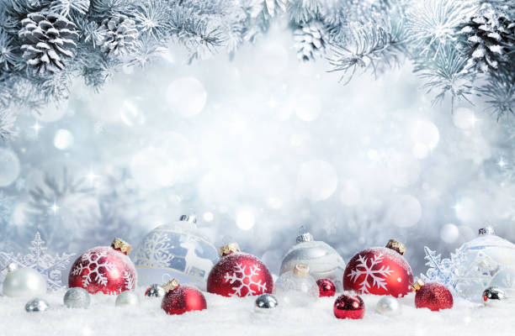
Fair Oak
Stubbington
Ashurst
Welcome Acts of Kindness
Marchwood
Denvilles
Brockenhurst

Slide 2
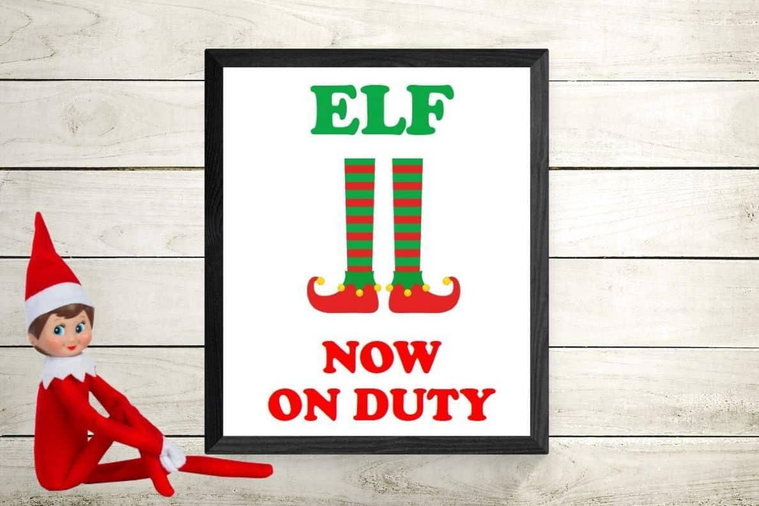
Welcome Acts of Kindness
13th December......

Slide 3
Welcome Acts of Kindness
13th December......Name the Polar Bear

Slide 4
Welcome Acts of Kindness
18th December...... Prize Draw! Win a £20 Welcome voucher!
Spend £10 in store and get automatically entered
for a chance to win!

Slide 5
Welcome Acts of Kindness
20th December......

